Slide 1
Capstone Project: Capstone_m_Adhaar Application

Slide 2

Develop an application to automate the process of applying for an Aadhaar card by making it smoother for Indian citizens.

Slide 3
Problem Statement and Motivation
Problem Statement:
In this project, you should be able to develop an application to automate the process of applying for an Aadhaar card by making it smoother for Indian citizens.

Slide 4
Problem Statement and Motivation
Real-World Scenario:
Varniraj Service Pvt. Ltd. is closely working with The Government of India to help them get a solution for processing applications for Aadhaar cards. The application registers citizens and lets them display their ID to process their Aadhaar card application.

Slide 5
Deliverables
Features of the application:
Registration
Login
Apply for a new Aadhaar card
Place a request for updating Aadhaar details
Apply for a duplicate Aadhaar card
Admin: Approve Aadhaar application and issue new Aadhaar number
Apply to close Aadhaar card (due to death)

Slide 6
Industry Relevance
Skills used in the project and their usage in the industry are given below:
Database: MySQL
Backend: Java Programming (Spring Boot, JPA, and Hibernate)
Frontend: Angular, Bootstrap, and HTML and CSS
Automation and testing technologies: Selenium and TestNG
DevOps tools and technologies: Git, GitHub, Jenkins, and Docker
Optional implementation: Kubernetes, AWS

Slide 7
Guidelines
Project development guidelines:
The project will be delivered within four sprints with every sprint delivering a Minimal Viable Product.
The development of all the project components is mandatory to perform proper sprint planning with user stories.
The learner should use the above mentioned technologies for different layers of the project.
The web application should be responsive and should fetch or send data dynamically without hard-coded values.

Slide 8
Guidelines
Project development guidelines:
The learner must maintain the version of the application over GitHub, and every new change should be sent to the repository.
The learner must implement a CI/CD pipeline using Jenkins.
The learner should also deploy and host the application on an AWS EC2 instance.
The learner should also implement automation testing before the application enters the CI/CD pipeline.

Slide 9
Guidelines
Project development guidelines:
The learner should use Git branching to perform basic automation testing of the application in it separately.
The learner should make a rich frontend of the application, which is user-friendly and easy for the user to navigate through the application.
There will be two portals in the application, the admin and the user portal.

Slide 10
Functionalities
Functionalities of the admin portal:
The admin portal deals with all the backend data generation. The admin user should be able to:
Log in through admin credentials
Approve new Aadhaar Card request
Verify request for duplicate Aadhaar
Display all issued Aadhaar Cards
Delete Aadhaar card details for dead citizens

Slide 11
Functionalities
Functionalities of the user portal:
It deals with user activities. The end-user should be able to:
Sign in to apply for a new Aadhaar Card
Login to see the Aadhaar number assigned by the admin
Update address, phone number, and date of birth on the Aadhaar Card
Request duplicate Aadhaar Card

Slide 12
Validations
Front-end Validation:
For admin: The password should have at least: One uppercase, one lowercase, one special character (@,#,&….), and one number.
For citizens: The password should consist of only digits.
Back-end Validation:
Mobile number validation should be applied.
Password length should not be less than 6 characters.
For citizens: The home page would authenticate only if the mobile number provided in Aadhaar is matching with the password.

Slide 13
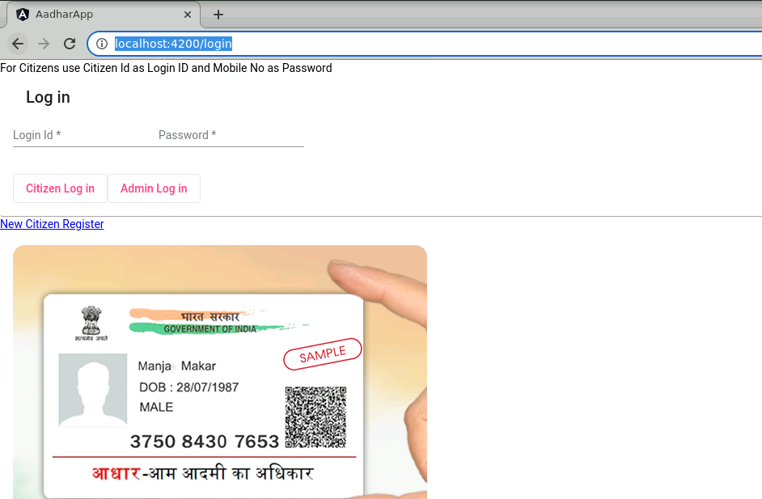
Login Page Screenshot

Slide 14
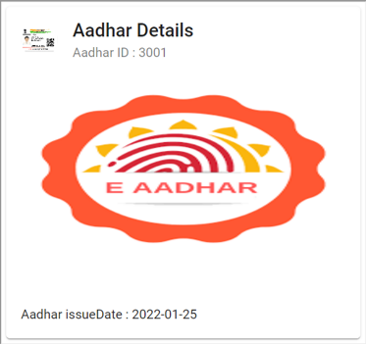
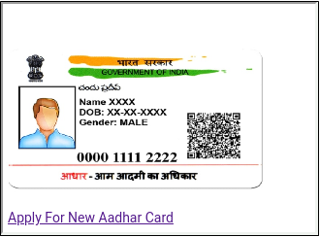
User Portal Screenshot

Slide 15
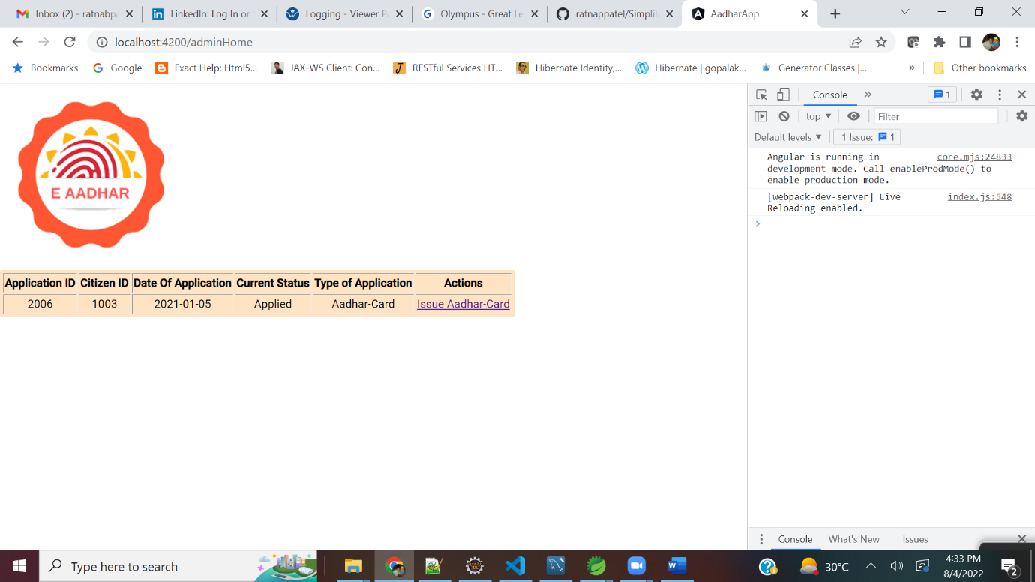
Admin Portal Screenshot

